Slide 1
Filter in Java Web Filter #Filter #Controller #JavaEE

Slide 2
Objectives
How to build application using MVC2 Pattern using Filter as Controller?
Filter
Filter Chain
Using Filter as Controller in MVC2 Design Pattern

Slide 3
Filter Requirements
Preprocess request and Postprocess response in web application
Build the Project CRUD, Online Shopping applying MVC2 pattern with Filter as Controller

Slide 4
Filter Overview
Are components that add functionality to the request and response processing of a Web Application
Intercept the requests and response that flow between a client and a Servlet/JSP.
Supports dynamic modification of requests and responses between client and web applications.
Dynamically access incoming requests from the user before the servlet processes the request
Access the outgoing response from the web resources before it reaches the user
Categorized according to the services they provide to the web applications
Resides in the web container along with the web applications
Was introduced as a Web component in Java servlet specification version 2.3

Slide 5
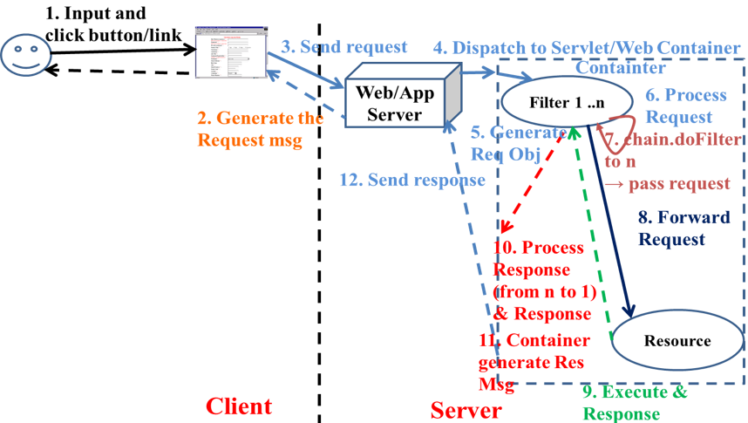
Filter Interactive Filter Model

Slide 6
Filter Usage
Authorize request
Altering request headers and modify data
Modify response headers and data
Authenticating the user
Comprising files
Encrypting data
Converting images
Logging and auditing filters
Filters that trigger resource access events

Slide 7
Filter Advantages
Optimization of the time taken to send a response
Compression of the content size before sending
Optimization of the bandwidth
Security
Identify the type of request coming from the Web client, such as HTTP and FTP, and invoke the Servlet that needs to process the request.
Retrieve the user information from the request parameters to authenticate the user.
Validate a client using Servlet filters before the client accesses the Servlet.
Identify the information about the MIME types and other header contents of the request.
Facilitate a Servlet to communicate with the external resources.
Intercept responses and compress it before sending the response to the client

Slide 8
Filter Life Cycle
Working of Filter
The filter intercepts the request from a user to the servlet
The filter then provides customized services
The filter sends the serviced response or request to the appropriate destination
Instantiation and Loading
Initialization init()
doFilter()
destroy()
Unavailable

Slide 9
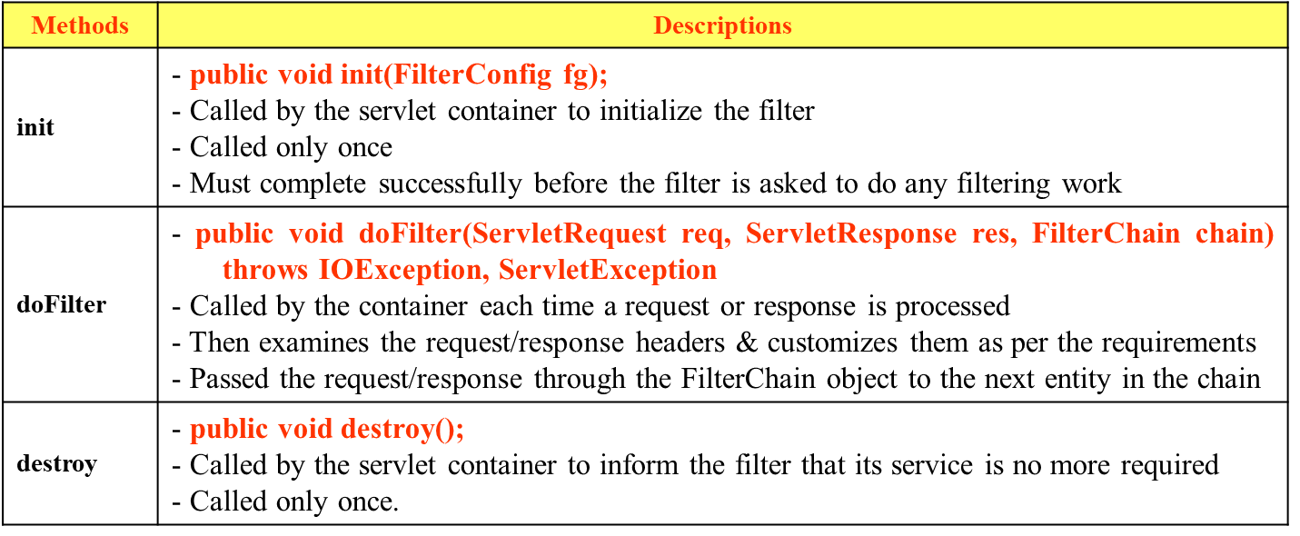
Filter API
Creates and handles the functionalities of a filter
Contains three interfaces
Filter Interface, FilterConfig Interface, FilterChain Interface
Filter Interface
Must be implemented to create a filter class extends javax.servlet.Filter
An object performs filtering tasks on the request and the response

Slide 10
Filter Configuration
In Web Deployment Descriptor
<web-app>
….
<filter>
<filter-name>Name of Filters</filter-name>
<filter-class>implemented Filter Class</filter-class>
[<init-param>
<param-name>parameter name</param-name>
<param-value>value </param-value>
</init-param>]
</filter>
<filter-mapping>
<filter-name>FilterName</filter-name>
<url-pattern>/context</url-pattern>
</filter-mapping>
….
</web-app>

Slide 11
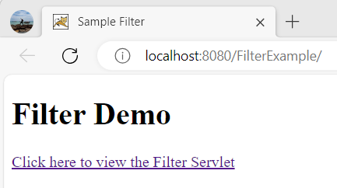
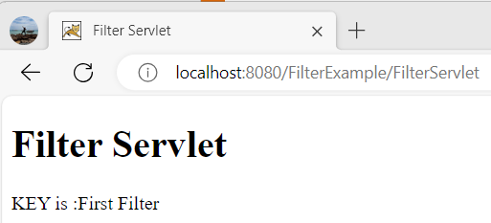
Filter Example
Building the web application shows as the following GUI in sequence

Slide 12
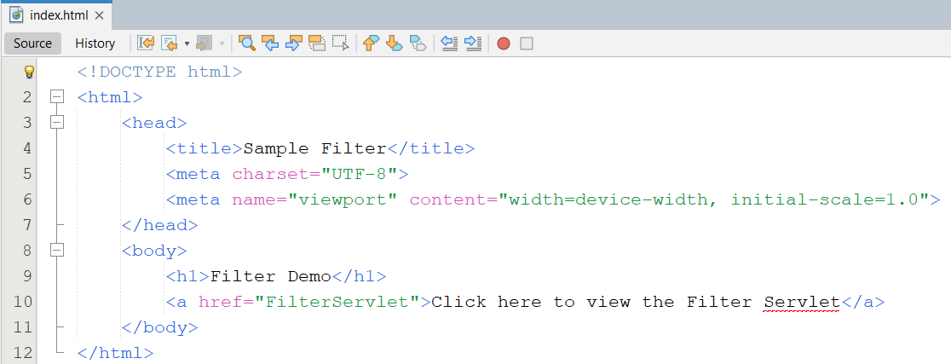
Filter Example
#1. Create index.html

Slide 13
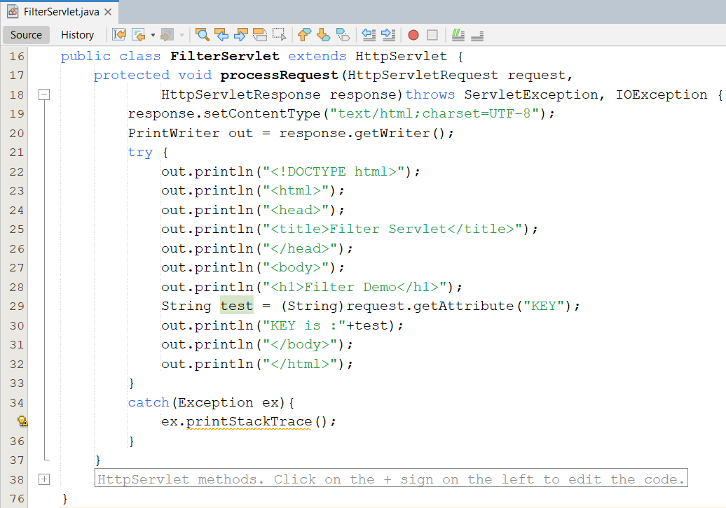
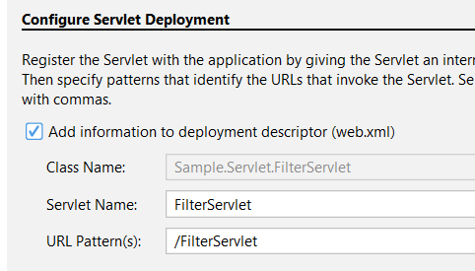
Filter Example
#2. Create a Servlet named FilterServlet.java

Slide 14
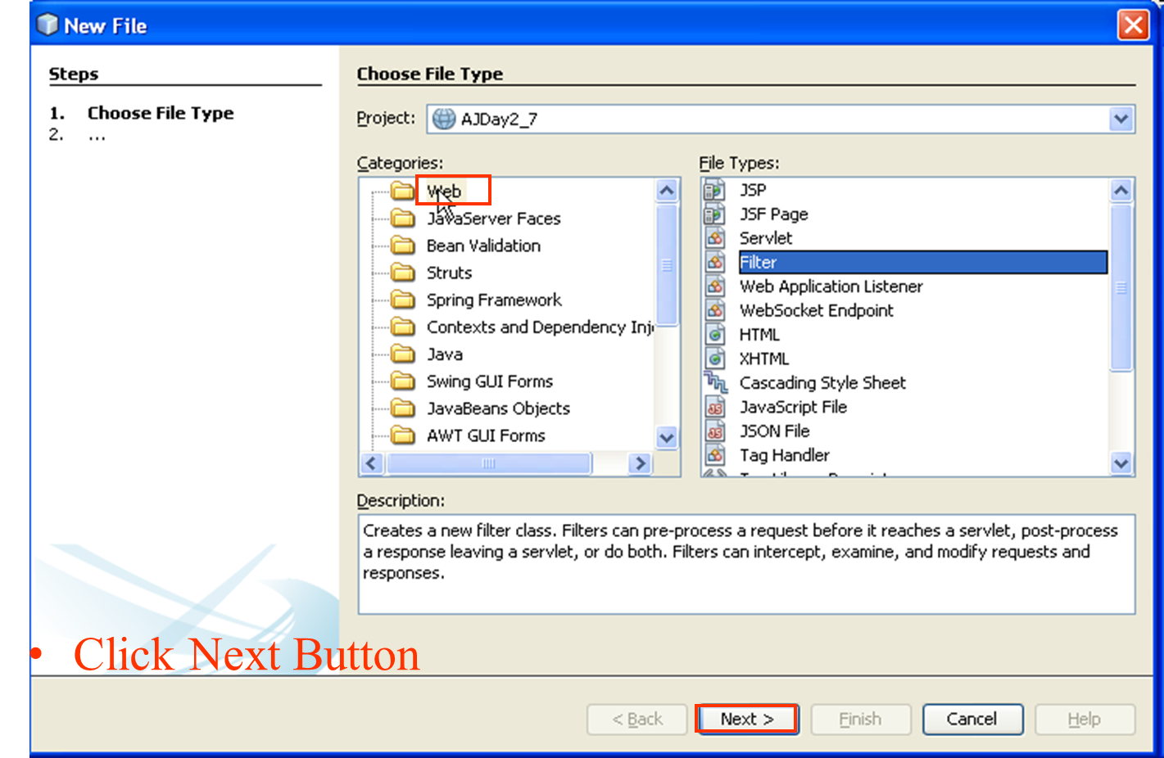
Filter Example
#3. Create a Filter named FirstFilter.java

Slide 15
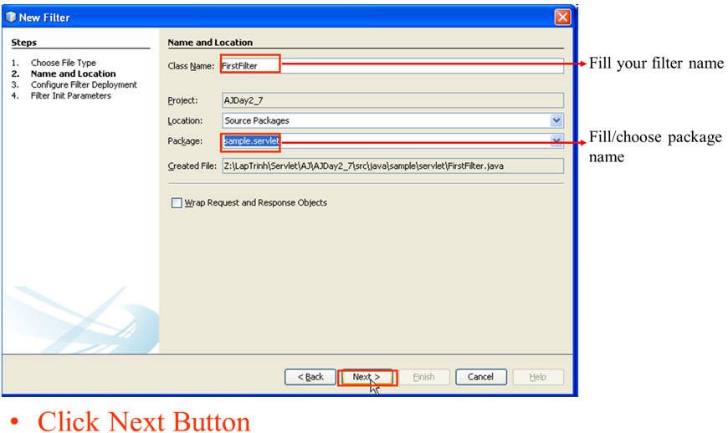
Filter Example

Slide 16
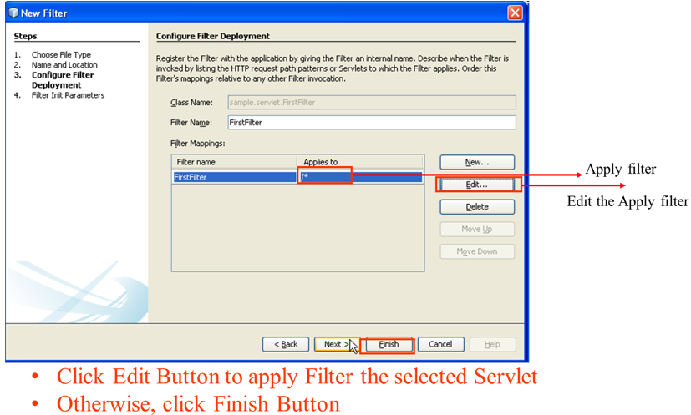
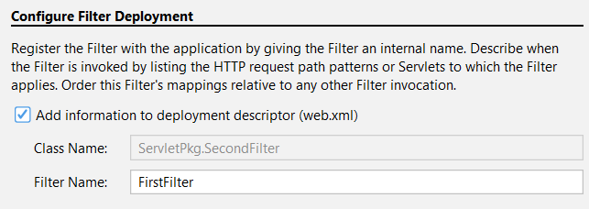
Filter Example

Slide 17
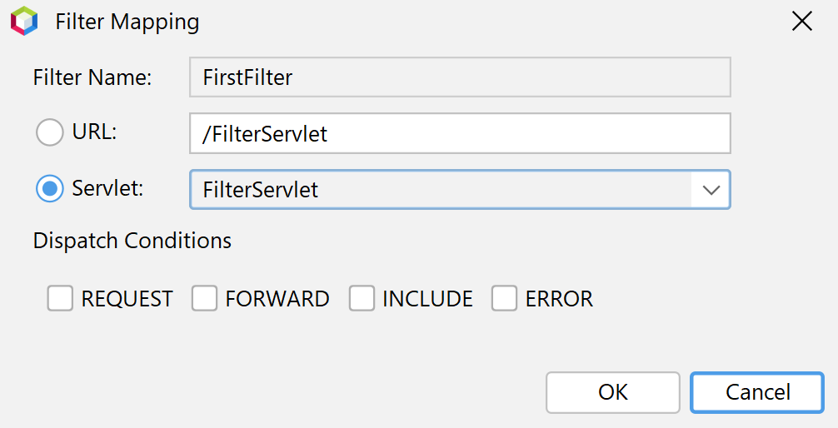
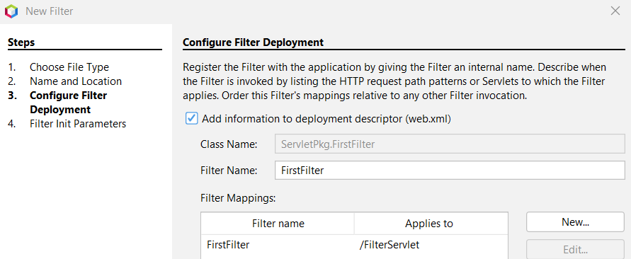
Filter Example
[Optional] Select the URL and typing the URL string, or Select the Servlet and choose the approximate Servlet in combo box

Slide 18
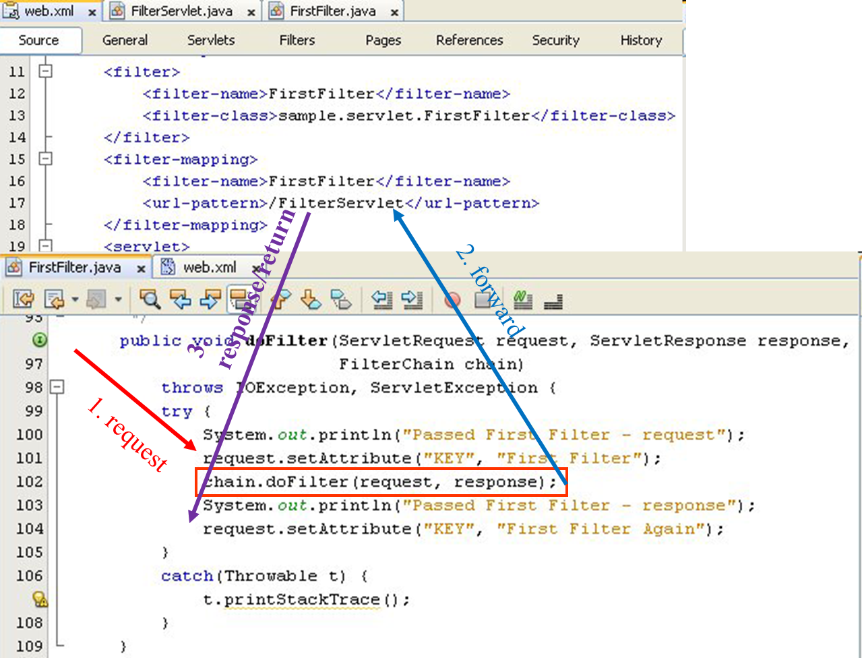
Filter Example

Slide 19
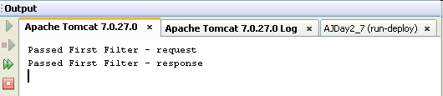
Filter Example

Slide 20
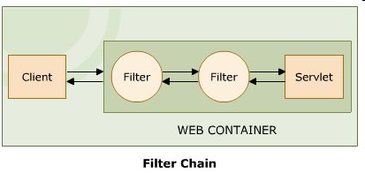
Filter Chain Definition
There can be more than one filter between the user and the endpoint – Invoke a series of filters
A request or a response is passed through one filter to the next in the filter chain. So each request and response has to be serviced by each filter forming a filter chain
If the Calling filter is last filter, will invoke web resource
FilterChain Interface
Provides an object through the web container
The object invokes the next filter in a filter chain starting from the first filter from a particular end. If the calling filter is the last filter in the chain, it will invoke the web resource, such as JSP and servlet.
Only implement doFilter() method.
Forces the next filter in the chain to be invoked

Slide 21
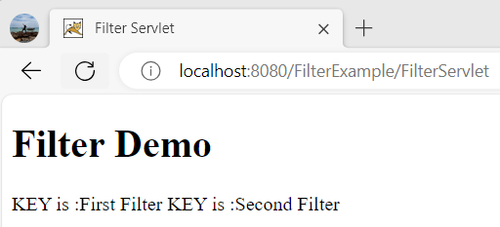
Filter Chain Example

Slide 22
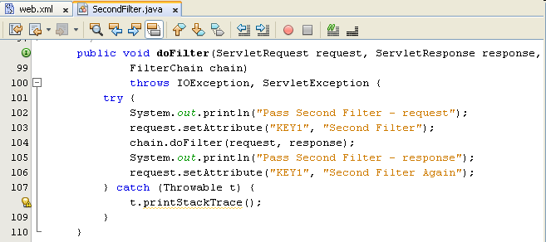
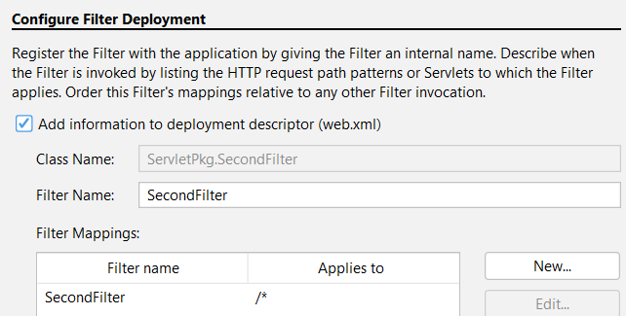
Filter Chain Example
#4. Create a Filter named SecondFilter.java

Slide 23
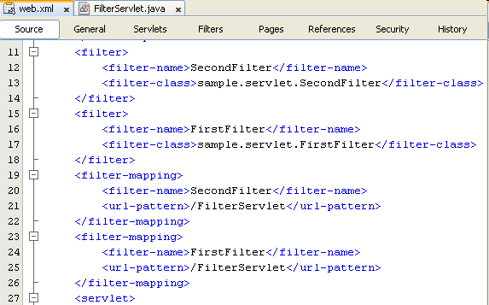
Filter Chain Example

Slide 24
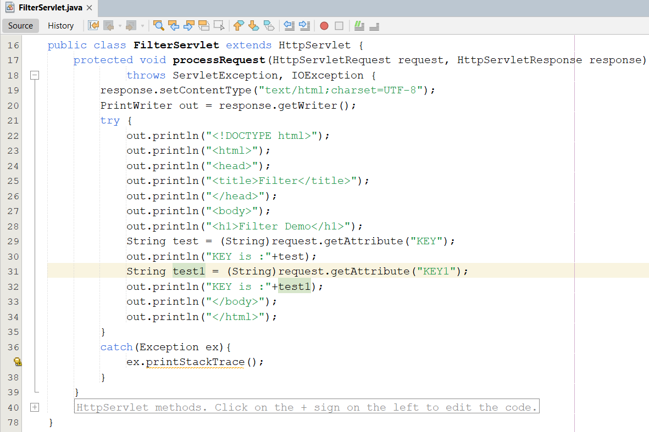
Filter Chain Example
#5. Update FilterServlet.java

Slide 25
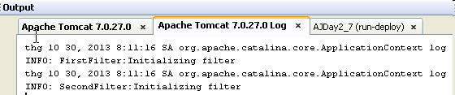
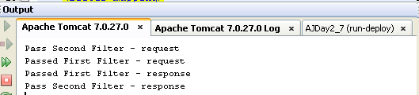
Filter Chain Example

Slide 26
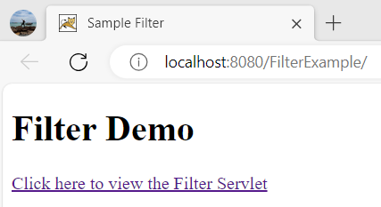
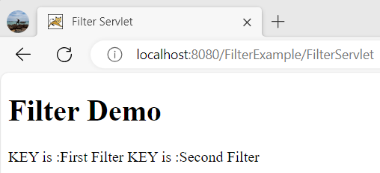
Filter Chain Example

Slide 27
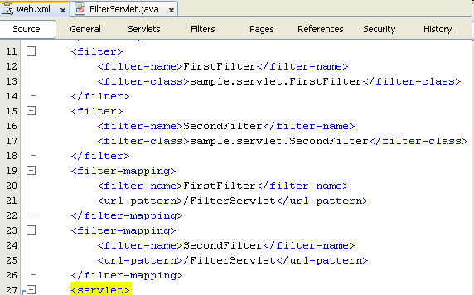
Filter Chain Example – Change position

Slide 28
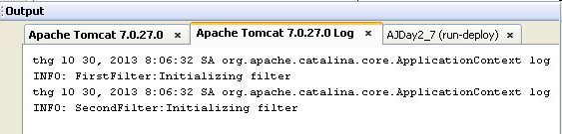
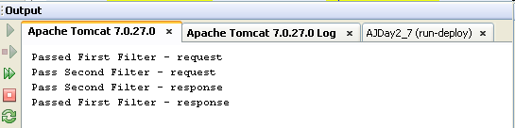
Filter Chain Example

Slide 29
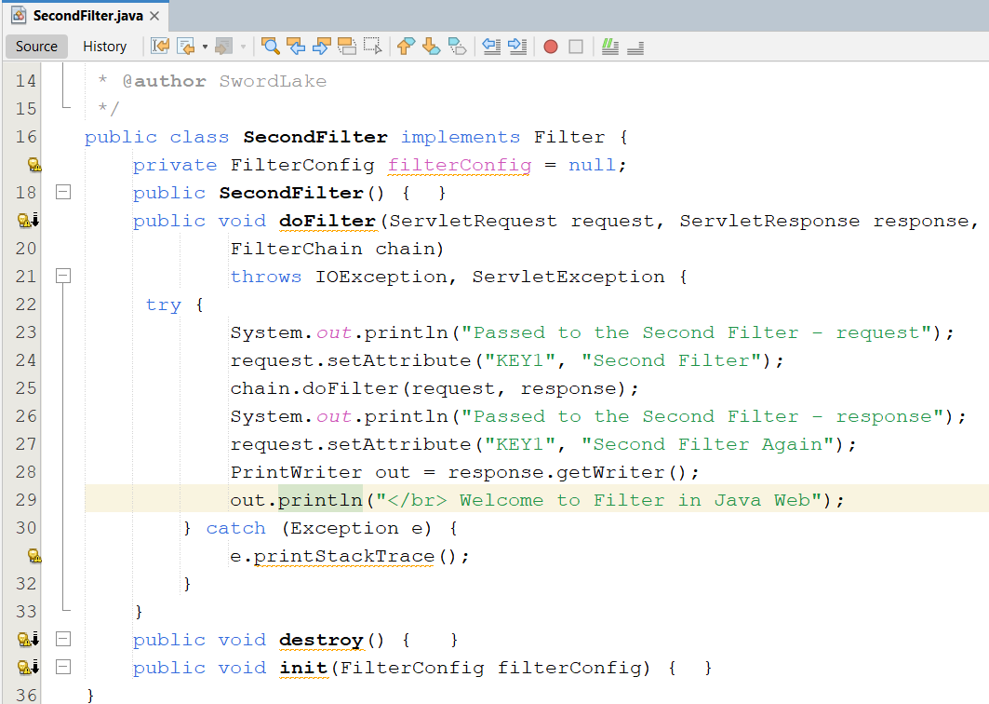
Filter Chain Example
#6. Update SecondFilter.java

Slide 30
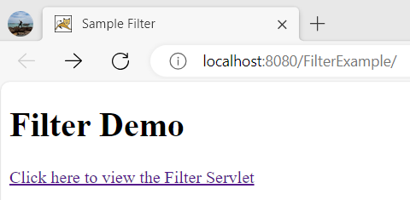
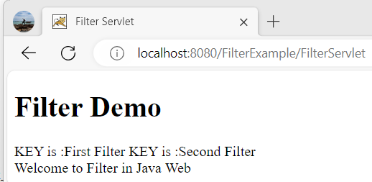
Filter Chain Example

Slide 31
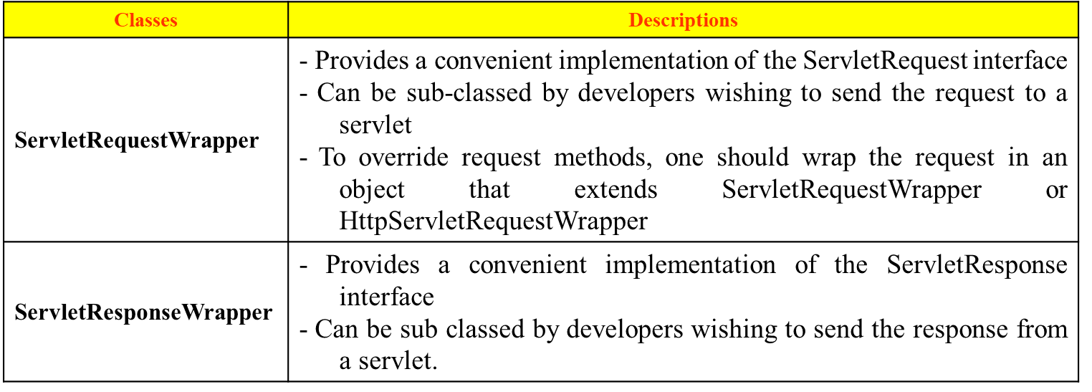
Filter Chain Wrapper Class
To modify or intercept the request or response before they can reach their logical destination, the required object can dynamically capture the request or response
Wrapper class
Creates the object to capture the request and response before they reach server and client respectively
The wrapper object generated by the filter implements the getWriter() and getOutputStream(), which returns a stand-in-stream. The stand-in-stream is passed to the servlet through the wrapper object
The wrapper object captures the response through the stand-in-stream and sends it back to the filter
Notes:
Intercept : chặn , ngăn lại

Slide 32
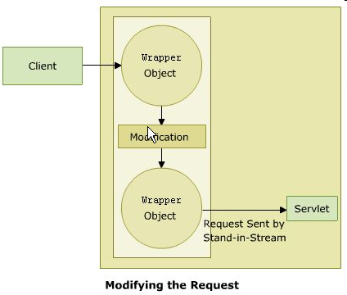
Filter Chain Wrapper Class – Altering Request
Create filter class extends to the ServletRequestWrapper or HttpServletRequestWrapper class.
The object captures the HttpRequest object from the client and sends it to the filers
Through the objects filter extends some services to the request.

Slide 33
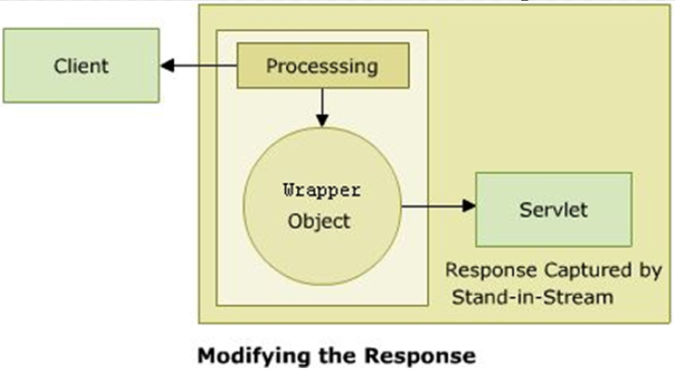
Filter Chain Wrapper Class – Altering Response
Create filter class extends to the ServletResponseWrapper or HttpServletResponseWrapper class.
The object overrides the getWriter() and getOutputStream() methods
This returns a stand in stream
The stand in stream is then passed to the servlet through the response wrapper object
This capture the response and sends it back to the filter and required alteration is carried out

Slide 34
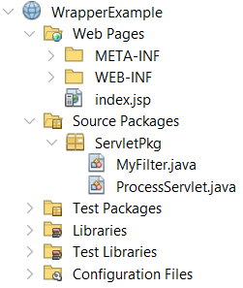
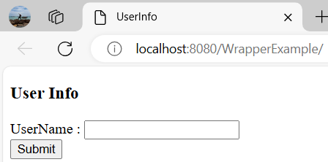
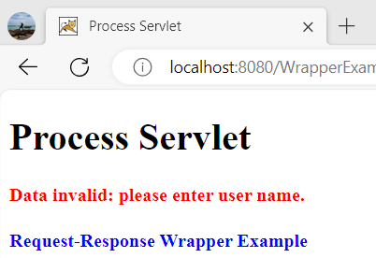
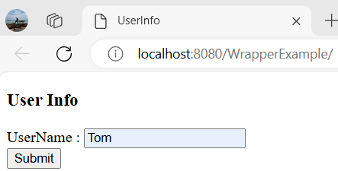
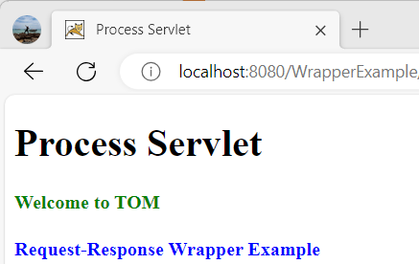
Filter Chain Wrapper Class – Example

Slide 35
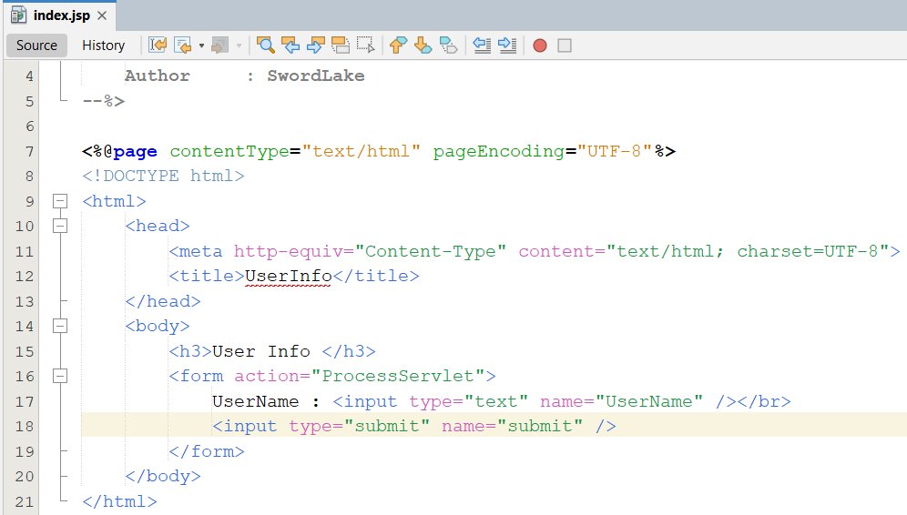
Filter Chain Wrapper Class – Example
Step 1 : Create Index.html page

Slide 36
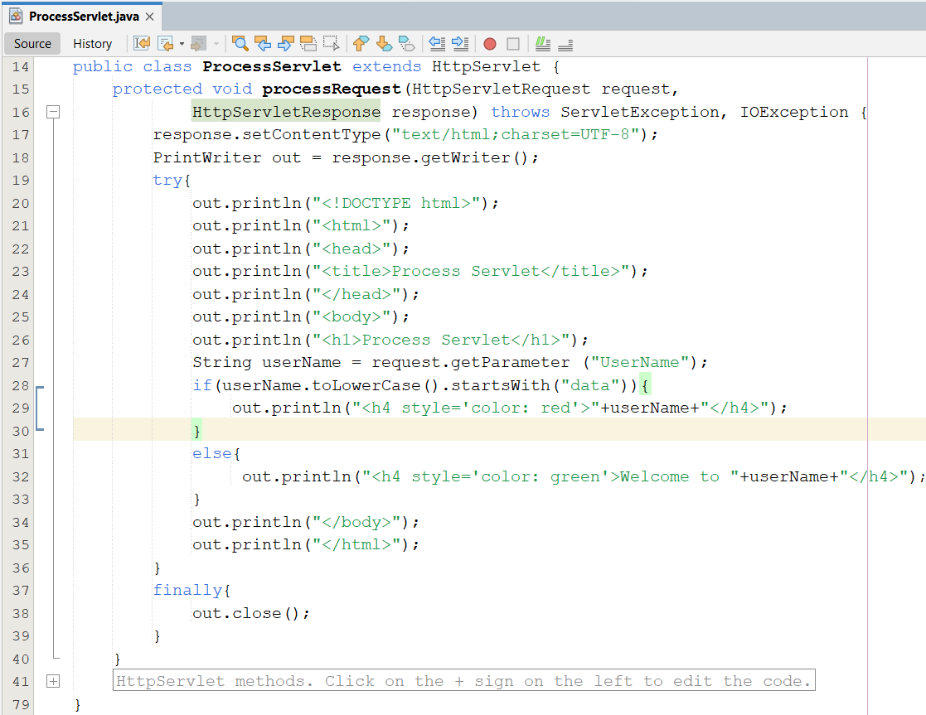
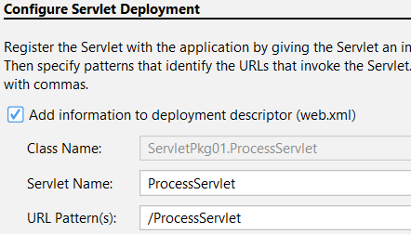
Filter Chain Wrapper Class – Example
Step 2 : Create ProcessServlet.java

Slide 37
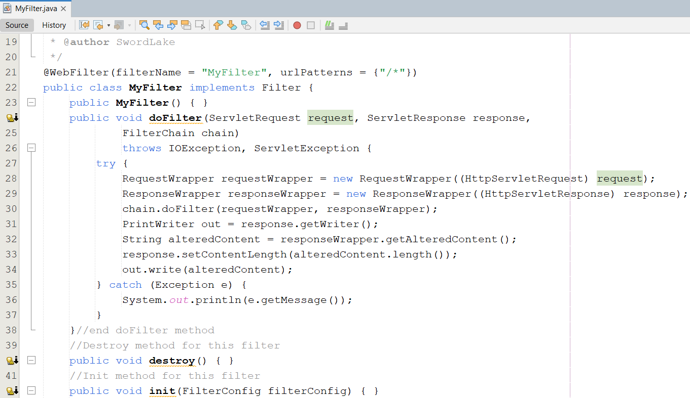
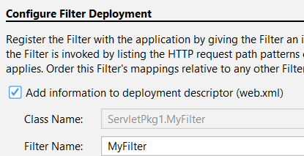
Filter Chain Wrapper Class – Example
Step 3 : Create MyFilter.java

Slide 38
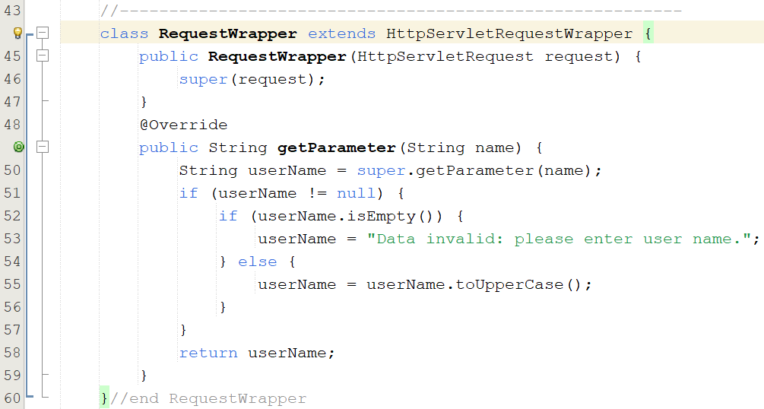
Filter Chain Wrapper Class – Example

Slide 39
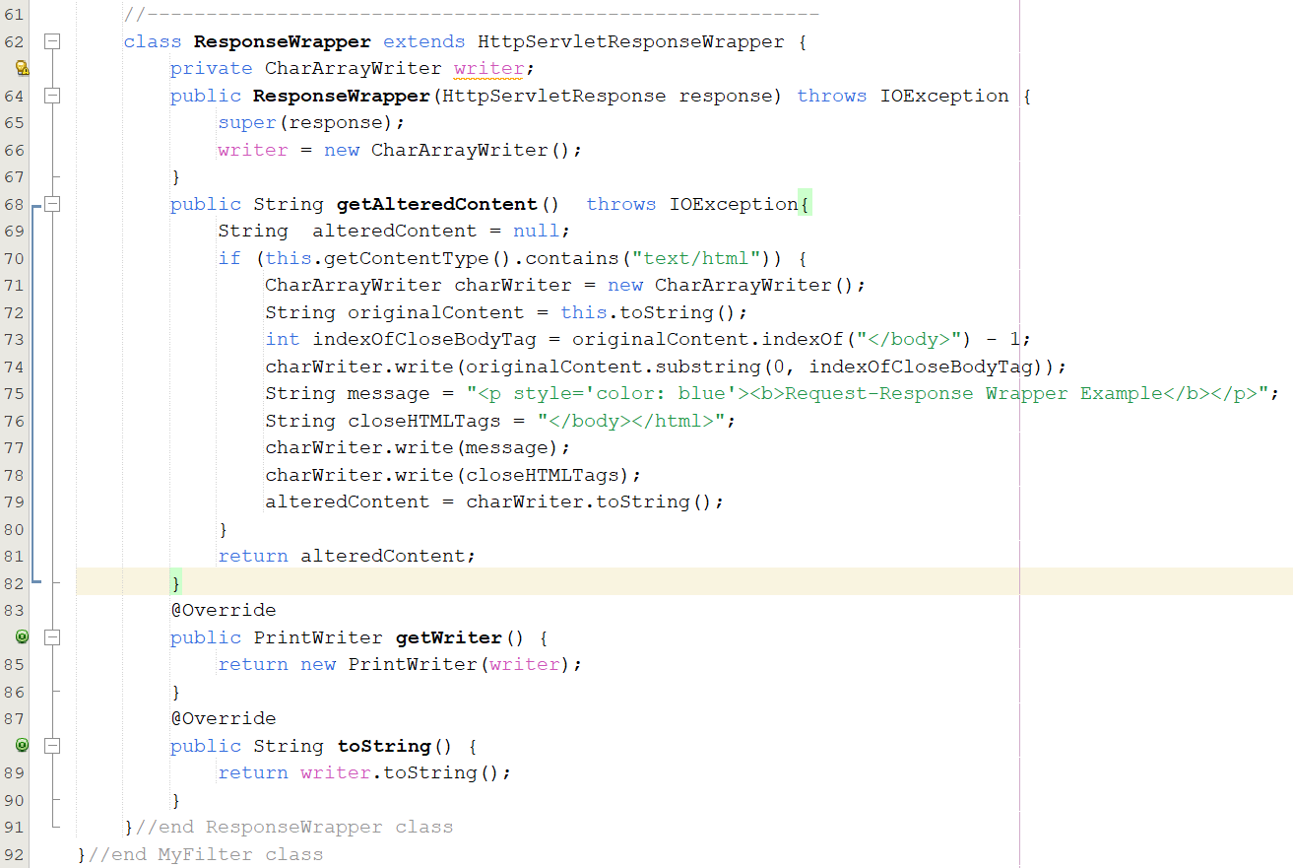
Filter Chain Wrapper Class – Example

Slide 40
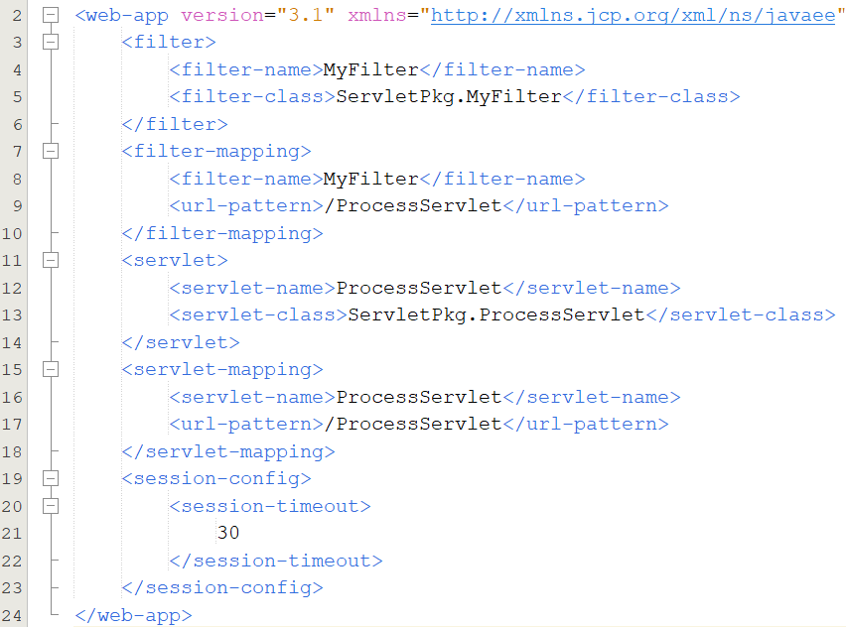
Filter Chain Wrapper Class – Example
Step 4 : Config for web.xml

Slide 41
Filter Chain Wrapper Class – Example
Step 5 : Run the project

Slide 42
MVC2 Filter Acts as Controller
While a servlet is the most common controller, a filter can act as a controller too
While a servlet only handles access to the dynamic part of the application, a filter can serve all the resources in application, including static ones
A filter as the controller allows to block all requests to the application, including request for static contents

Slide 43
Summary
How to build application using MVC2 Pattern using Filter as Controller?
Filter
Filter Chain
Using Filter as Controller in MVC2 Design Pattern
Q&A
Do Lab07_ManageUsersByMVC2_JSTL_Filter.pdf

Slide 44
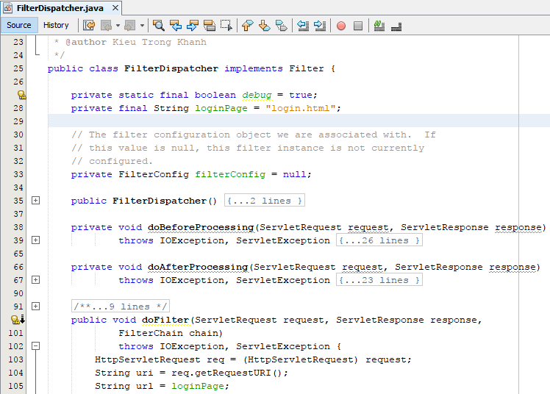
Appendix MVC2 using Filter as Controller

Slide 45
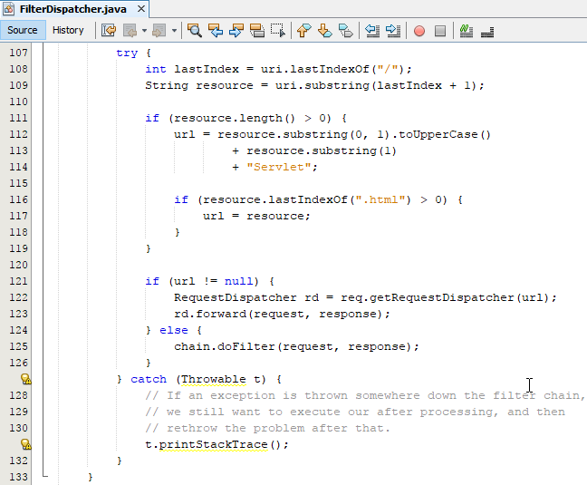
Appendix MVC2 using Filter as Controller

Slide 46
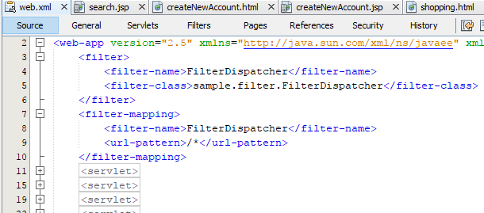

Appendix MVC2 using Filter as Controller

Slide 47

Appendix MVC2 using Filter as Controller

Slide 48

Appendix MVC2 using Filter as Controller

Slide 49

Appendix MVC2 using Filter as Controller

Slide 50

Appendix MVC2 using Filter as Controller

Slide 51

Appendix MVC2 using Filter as Controller

Slide 52

Appendix MVC2 using Filter as Controller

Slide 53

Appendix MVC2 using Filter as Controller

Slide 54

Appendix MVC2 using Filter as Controller

Slide 55

Appendix MVC2 using Filter as Controller

Slide 56

Appendix MVC2 using Filter as Controller

Slide 57


Appendix MVC2 using Filter as Controller

